Slide 1
UPPER SIXTH ARTS
GEOGRAPHY
Practical Work 2
Population Distribution and Altitude
Notes:
Good morning, class, and welcome to our geography lesson. I am your geography teacher, Mr Kamdem. Today we are starting Practical Work 2: Population Distribution and Altitude.

Slide 2
CLASS INFO
Class, Chapter and Duration
Class | Upper Sixth Arts
Chapter | Module 4: Understanding and managing population dynamics across the world in general and Cameroon in particular
Duration | 2 periods (2 × 50 minutes)
Notes:
This lesson is for Upper Sixth Arts. It belongs to Module 4: Understanding and managing population dynamics across the world in general and Cameroon in particular. We shall need 2 periods to cover it.

Slide 3
IDENTIFICATION
Lesson Identification
Topic | Population Numbers
Sub-topic | Population Density and Distribution
Lesson | Practical Work 2: Population Distribution and Altitude
Notions / Concepts | Altitude, population density, peak, decline, tropical highland, exception.
Syllabus focus | Reading and interpreting graphs of population distribution with altitude: general trend, peaks and declines, exceptions in tropical highlands.
Competence | Learners are able to read, describe and explain a graph of population distribution with altitude.
Notes:
Our topic is Population Numbers, and the sub-topic is Population Density and Distribution. The key notions we shall use today are: altitude, population density, peak, decline, tropical highland, exception. At the end, you should be able to do this: learners are able to read, describe and explain a graph of population distribution with altitude.

Slide 4

HOMEWORK CORRECTION
Correction of the Homework
Question (Lesson 3: Spatial Population Distribution and its Factors):
State how population density changes as altitude increases.
Notes:
Before we start the new lesson, let us correct the homework I gave you at the end of Lesson 3: Spatial Population Distribution and its Factors. The question was: State how population density changes as altitude increases. Take out your exercise books.

Slide 5
HOMEWORK CORRECTION
Correction: Possible Answer
In general, population density decreases as altitude increases, except in some tropical highlands.
Notes:
Here is a good answer. In general, population density decreases as altitude increases, except in some tropical highlands. Compare it with your own answer and correct your work in red.

Slide 6
LESSON PLAN
Lesson Plan
Correction of the homework
Objectives and recall
Real-life situation and action to take
Learning activities
Board summary
Evaluation, remediation and homework
Notes:
Here is the plan of our lesson today. First, we shall correct the homework. Then we shall look at the objectives and recall what you already know. After that, we shall study a situation from real life and the action to take, and do the learning activities. Finally, we shall copy the board summary, do the evaluation and the remediation, and I will give you the homework.

Slide 7
OBJECTIVES
Objectives
By the end of this lesson, you should be able to:
Read a graph of population by altitude.
Describe the general trend of population with altitude.
Explain peaks and declines of density.
Notes:
Take your time to copy this part; we will continue together.

Slide 8
OBJECTIVES
Objectives (continued)
Explain the exceptions in tropical highlands.
Notes:
By the end of this lesson, you should be able to do four things. Number 1: read a graph of population by altitude. Number 2: describe the general trend of population with altitude. Number 3: explain peaks and declines of density. Number 4: explain the exceptions in tropical highlands.

Slide 9
PREVIOUS KNOWLEDGE
Previous Knowledge
Density generally falls with altitude.
Temperature falls by about 0.6 °C every 100 m.
The Bamenda Highlands are densely populated.
Notes:
Let us first remember what you already know. Density generally falls with altitude. Temperature falls by about 0.6 °C every 100 m. The Bamenda Highlands are densely populated. Keep this in mind, because we shall build on it today.

Slide 10
REAL-LIFE SITUATION
Situation in Real Life
In the Mount Cameroon area, farms and towns such as Buea and Limbe are found on the lower slopes, but there are no villages near the summit (4,095 m).
Yet the Bamenda Highlands, at 1,000 to 2,000 m, are very crowded.
Notes:
Take your time to copy this part; we will continue together.

Slide 11
REAL-LIFE SITUATION
Situation in Real Life (continued)
A student studying a graph of population and altitude asks: "How do I read this graph, and why does density not always fall with altitude?"
Notes:
Listen carefully to this situation from real life. In the Mount Cameroon area, farms and towns such as Buea and Limbe are found on the lower slopes, but there are no villages near the summit (4,095 m). Yet the Bamenda Highlands, at 1,000 to 2,000 m, are very crowded. A student studying a graph of population and altitude asks: "How do I read this graph, and why does density not always fall with altitude?" Think about it, because I am going to ask you some questions.

Slide 12
REAL-LIFE SITUATION
Situation: Question 1
What is the problem in the situation?
Notes:
Question 1: What is the problem in the situation? Think for a moment, then raise your hand to answer.

Slide 13
REAL-LIFE SITUATION
Answer
The student cannot read and explain a graph of population and altitude.
Notes:
Good. The student cannot read and explain a graph of population and altitude.

Slide 14
REAL-LIFE SITUATION
Situation: Question 2
Why is there no village near the summit of Mount Cameroon?
Notes:
Question 2: Why is there no village near the summit of Mount Cameroon? Think for a moment, then raise your hand to answer.

Slide 15
REAL-LIFE SITUATION
Answer
It is too cold, steep and high, with little oxygen.
Notes:
Good. It is too cold, steep and high, with little oxygen.

Slide 16
REAL-LIFE SITUATION
Situation: Question 3
Why are the Bamenda Highlands crowded?
Notes:
Question 3: Why are the Bamenda Highlands crowded? Think for a moment, then raise your hand to answer.

Slide 17
REAL-LIFE SITUATION
Possible Answer
They are cool, healthy and fertile compared with the hot lowlands.
Notes:
Good. They are cool, healthy and fertile compared with the hot lowlands.

Slide 18
ACTION TO TAKE
Action to Take
Always describe the general trend first, then the exceptions, with figures read from the graph.
Notes:
From this situation, the action we are working towards in this lesson is the following: always describe the general trend first, then the exceptions, with figures read from the graph.

Slide 19
JUSTIFICATION
Justification of the Lesson
This practical work trains us to read graphs and to explain the role of altitude in the distribution of people.
Notes:
Why is this lesson important for you? This practical work trains us to read graphs and to explain the role of altitude in the distribution of people.

Slide 20
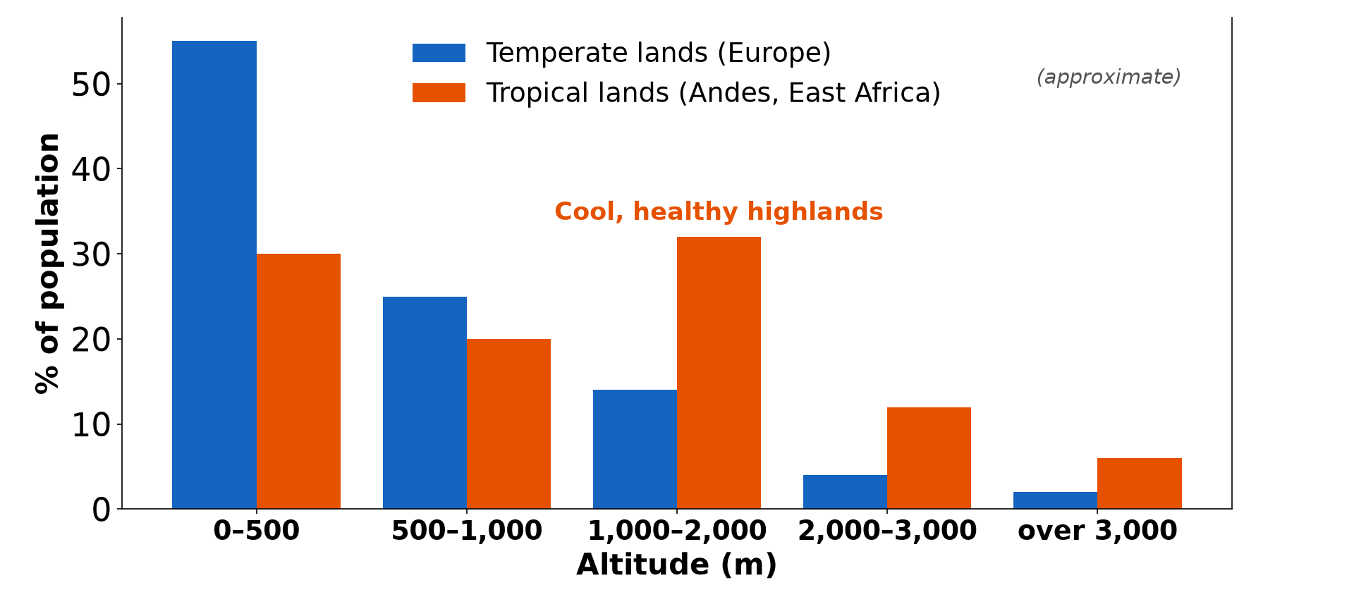
1. GENERAL TREND
Activity 1
Population by altitude.
Notes:
Activity 1. Look carefully at this diagram: population by altitude. Observe every detail before I ask the question.

Slide 21
1. GENERAL TREND
Activity 1: Question
In temperate lands, in which altitude class do most people live?
Notes:
Here is the question for Activity 1: In temperate lands, in which altitude class do most people live? Take one minute to think and write your answer in your rough notebook.

Slide 22
1. GENERAL TREND
Activity 1: Answer
In the lowest class, 0–500 m.
Notes:
Let us check the answer together. In the lowest class, 0–500 m.

Slide 23
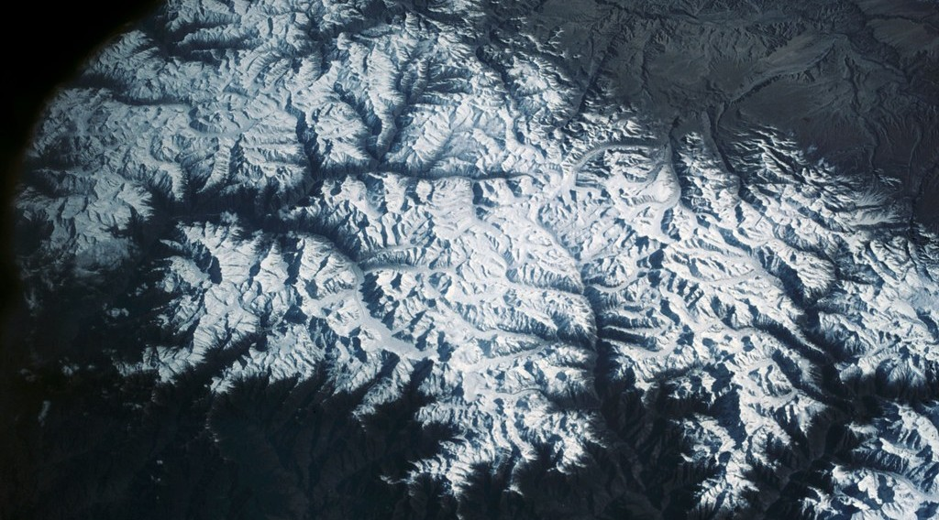
1. GENERAL TREND
Activity 2
High mountains.
Notes:
Activity 2. Look carefully at this picture: high mountains. Observe every detail before I ask the question.

Slide 24
1. GENERAL TREND
Activity 2: Question
Give two reasons why density is very low above 3,000 m.
Notes:
Here is the question for Activity 2: Give two reasons why density is very low above 3,000 m. Take one minute to think and write your answer in your rough notebook.

Slide 25
1. GENERAL TREND
Activity 2: Answer
Cold temperatures, little oxygen, steep slopes and poor soils.
Notes:
Let us check the answer together. Cold temperatures, little oxygen, steep slopes and poor soils.

Slide 26
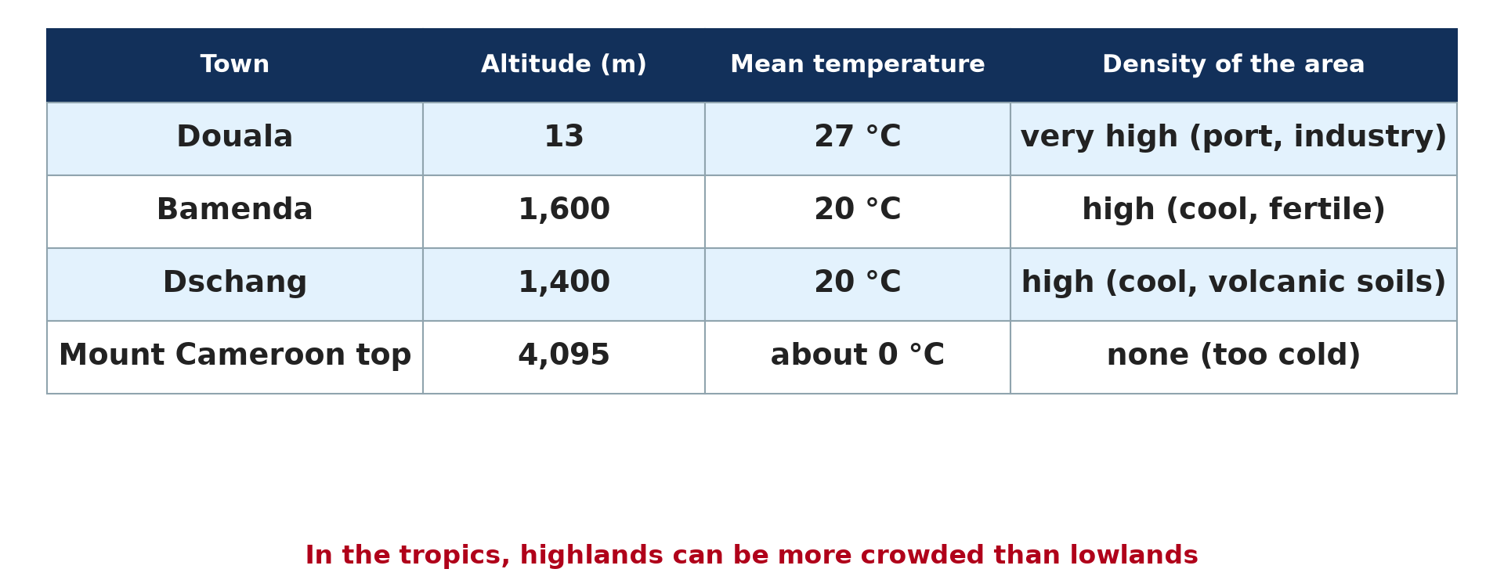
2. EXCEPTIONS
Activity 3
Towns, altitude and temperature in Cameroon.
Notes:
Activity 3. Look carefully at this diagram: towns, altitude and temperature in Cameroon. Observe every detail before I ask the question.

Slide 27
2. EXCEPTIONS
Activity 3: Question
Why is Bamenda more pleasant to live in than a hot lowland?
Notes:
Here is the question for Activity 3: Why is Bamenda more pleasant to live in than a hot lowland? Take one minute to think and write your answer in your rough notebook.

Slide 28
2. EXCEPTIONS
Activity 3: Answer
Its altitude gives it a cooler, healthier climate.
Notes:
Let us check the answer together. Its altitude gives it a cooler, healthier climate.

Slide 29
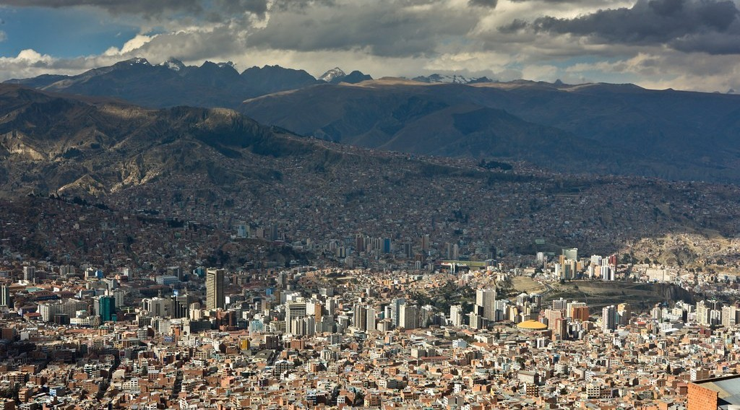
2. EXCEPTIONS
Activity 4
La Paz, Bolivia.
Notes:
Activity 4. Look carefully at this picture: la Paz, Bolivia. Observe every detail before I ask the question.

Slide 30
2. EXCEPTIONS
Activity 4: Question
Why does La Paz have a large population at about 3,600 m?
Notes:
Here is the question for Activity 4: Why does La Paz have a large population at about 3,600 m? Take one minute to think and write your answer in your rough notebook.

Slide 31
2. EXCEPTIONS
Activity 4: Answer
It is the seat of government and the main economic centre of Bolivia.
Notes:
Let us check the answer together. It is the seat of government and the main economic centre of Bolivia.

Slide 32

3. INTERPRETATION
Activity 5
Tea on tropical highlands.
Notes:
Activity 5. Look carefully at this picture: tea on tropical highlands. Observe every detail before I ask the question.

Slide 33
3. INTERPRETATION
Activity 5: Question
Which activity keeps mid-altitude areas populated in the tropics?
Notes:
Here is the question for Activity 5: Which activity keeps mid-altitude areas populated in the tropics? Take one minute to think and write your answer in your rough notebook.

Slide 34
3. INTERPRETATION
Activity 5: Answer
Plantation farming of tea and coffee, and market gardening.
Notes:
Let us check the answer together. Plantation farming of tea and coffee, and market gardening.

Slide 35
BOARD SUMMARY
Board Summary
Topic: Population Numbers
Sub-topic: Population Density and Distribution
Practical Work 2: Population Distribution and Altitude
Notes:
Now we are going to copy the board summary. Write the title and the headings neatly in your notebooks. I will give you enough time for each slide, so do not rush.

Slide 36
BOARD SUMMARY
DEFINITIONS
The key terms of this lesson are defined as follows:
Altitude: It is the height of a place above sea level.
Peak (on a graph): It is the highest value of a curve or of a bar, showing where density is highest.
Notes:
Let us copy the definitions. The key terms of this lesson are defined as follows. On this slide we have Altitude and Peak (on a graph). Write each point on a new line, with the key term first, and explain it in your own words when we revise. When you finish, we go to the next slide.

Slide 37
BOARD SUMMARY
DEFINITIONS (continued)
Decline (on a graph): It is a fall in the values, showing where density decreases.
Notes:
We continue with the definitions. On this slide we have Decline (on a graph). Write each point on a new line, with the key term first, and explain it in your own words when we revise.

Slide 38
BOARD SUMMARY
1. Reading the Graph
A graph of population and altitude is read in the following steps:
Axes: Altitude in metres is on the horizontal axis, and population density or the percentage of population is on the vertical axis. Read the title and the units before describing the graph.
Illustration: population and altitude
Notes:
Let us copy Reading the Graph. A graph of population and altitude is read in the following steps. Copy the point on Axes on the left, then draw the diagram on the right: population and altitude. Give it a title and label it clearly.

Slide 39
BOARD SUMMARY
1. Reading the Graph
General trend and figures: First describe the overall direction: in most regions, density falls as altitude rises. Support the description with values read from the graph, such as the share of people below 500 m.
Notes:
We continue with Reading the Graph. Copy the point on General trend and figures: write the key term first, then its explanation.

Slide 40
BOARD SUMMARY
1. Reading the Graph
Peaks and declines: Then identify where density rises or falls sharply. Finally, explain each change with physical and human factors.
Notes:
We continue with Reading the Graph. Copy the point on Peaks and declines: write the key term first, then its explanation.

Slide 41

BOARD SUMMARY
2. The General Pattern
Density generally changes with altitude as follows:
Low altitudes (0 to 500 m): They are very densely populated because of fertile plains, water, easy transport and big cities. The Nile delta and Bangladesh are examples.
Illustration: a fertile lowland
Notes:
Let us copy The General Pattern. Density generally changes with altitude as follows. Copy the point on Low altitudes (0 to 500 m) on the left, then draw the diagram on the right: a fertile lowland. Give it a title and label it clearly.

Slide 42
BOARD SUMMARY
2. The General Pattern
Medium altitudes (500 to 2,000 m): Densities vary a lot at these heights. Fertile plateaux are well populated, but steep slopes discourage settlement.
Notes:
We continue with The General Pattern. Copy the point on Medium altitudes (500 to 2,000 m): write the key term first, then its explanation.

Slide 43
BOARD SUMMARY
2. The General Pattern
High altitudes (above 2,000 m): Densities are very low because of cold, lack of oxygen, steep slopes and poor soils, as in the Himalayas. Above 3,000 m, settlements become scattered and activities are limited to herding and tourism.
Illustration: the Himalayas
Notes:
Copy the point on High altitudes (above 2,000 m) on the left, then draw the diagram on the right: the Himalayas. Give it a title and label it clearly.

Slide 44
BOARD SUMMARY
3. Exceptions and Special Cases
The general pattern has the following exceptions:
Tropical highlands: In the tropics, highlands are cooler and free of some diseases such as malaria, so they attract people. Bamenda (about 1,600 m) and Dschang (about 1,400 m) have dense populations and a mild climate of about 20 °C.
Illustration: altitude and density
Notes:
Let us copy Exceptions and Special Cases. The general pattern has the following exceptions. Copy the point on Tropical highlands on the left, then draw the diagram on the right: altitude and density. Give it a title and label it clearly.

Slide 45
BOARD SUMMARY
3. Exceptions and Special Cases
Plantation highlands: Mid-altitude areas with tea and coffee plantations keep high densities, as in Kenya and the Western Highlands of Cameroon. The plantations need many workers.
Illustration: tea on the highlands
Notes:
Copy the point on Plantation highlands on the left, then draw the diagram on the right: tea on the highlands. Give it a title and label it clearly.

Slide 46
BOARD SUMMARY
3. Exceptions and Special Cases
High capital cities: La Paz in Bolivia, at about 3,600 m, is large because it is the seat of government. Quito, the capital of Ecuador, lies at about 2,850 m.
Illustration: La Paz
Notes:
Copy the point on High capital cities on the left, then draw the diagram on the right: la Paz. Give it a title and label it clearly.

Slide 47
FORMATIVE EVALUATION
Evaluation 1
Why do low-altitude areas generally support high densities?
Notes:
Now let us check what you have understood. Question 1: Why do low-altitude areas generally support high densities? Answer in your exercise book.

Slide 48
FORMATIVE EVALUATION
Expected Answer
They have fertile plains, water, a warm climate, easy transport and large towns.
Notes:
The expected answer is: they have fertile plains, water, a warm climate, easy transport and large towns. If you got it right, well done.

Slide 49
FORMATIVE EVALUATION
Evaluation 2
Give one high-altitude area with a large population and explain why.
Notes:
Now let us check what you have understood. Question 2: Give one high-altitude area with a large population and explain why. Answer in your exercise book.

Slide 50
FORMATIVE EVALUATION
Expected Answer
La Paz (about 3,600 m), the seat of government of Bolivia; or the Ethiopian Highlands, cooler and healthier than the lowlands.
Notes:
The expected answer is: la Paz (about 3,600 m), the seat of government of Bolivia; or the Ethiopian Highlands, cooler and healthier than the lowlands. If you got it right, well done.

Slide 51
REMEDIATION
Remediation
Fill in the blanks:
In general, density ______ as altitude rises.
Tropical highlands are densely populated because they are ______.
La Paz is at about ______ m.
Notes:
For those who need more practice, fill in the blanks in your exercise book. The answers are: number 1, decreases (falls); number 2, cooler (healthier); number 3, 3,600.

Slide 52
HOMEWORK
Homework
Name one push factor of rural-urban migration in Cameroon.
Notes:
For your homework: Name one push factor of rural-urban migration in Cameroon. We shall correct it at the beginning of our next lesson.

Slide 53
NEXT LESSON
Next Lesson
Our next lesson will be on:
Lesson 4: Modifications of Population Distribution
Notes:
Our next lesson will be on Lesson 4: Modifications of Population Distribution. Thank you for your attention, and see you next time.

Slide 54
BILINGUAL GAME
Bilingual Game (Jeu Bilingue)
English | Français
Altitude | L'altitude
Graph | Le graphique
Trend | La tendance
Peak | Le pic
Highland | La haute terre
Lowland | La basse terre
Notes:
Let us play the bilingual game. I say a word in English, and you give me the French word. Then we do the reverse.

Slide 55
LOGBOOK
Official Logbook (1/2)
Module / Topic | Population Numbers
Lesson Title | Practical Work 2: Population Distribution and Altitude
Expected Learning Outcomes | Read a graph of population by altitude. Describe the general trend of population with altitude. Explain peaks and declines of density. Explain the exceptions in tropical highlands.
Competence | Learners are able to read, describe and explain a graph of population distribution with altitude.
Notes:
I record this information in the official logbook of the class after the lesson.

Slide 56
LOGBOOK
Official Logbook (2/2)
Matter Taught | DEFINITIONS; Reading the Graph; The General Pattern; Exceptions and Special Cases.
Evaluation | Formative evaluation and remediation exercise.
Homework | Name one push factor of rural-urban migration in Cameroon.
Enrolment / Present / Absent | ____ / ____ / ____
Achievement | To be completed after the lesson.
Notes:
I complete the second page of the logbook: the matter taught, the evaluation, the homework and the attendance.

Slide 57
TEACHER'S NOTE
Teacher's Note
Timing: Homework correction, plan, objectives 8 min | Recall, situation, action 10 min | 5 activities 30 min | Board summary (copying) 30 min | Evaluation, remediation 10 min | Homework, next lesson 5 min | Logbook 7 min
Without the projector (Activity 1): draw the bars from a table.
Without the projector (Activity 2): describe the summit of Mount Cameroon.
Without the projector (Activity 3): write the table on the board.
Without the projector (Activity 4): locate Bolivia on a map.
Without the projector (Activity 5): name crops of the Western Highlands.
Notes:
This slide is for me, the teacher: it gives the timing of the lesson and what to do if the projector is not available.

Slide 58
REFERENCES
References
Geography Syllabus for Sixth Forms (Lower and Upper Sixth), MINESEC, 2019 — Module 4 (Population Geography).
Teacher's course notes: Mr KAMDEM E., Population Geography (USA), GBHS Garoua, 2026.
United Nations, World Population Prospects 2024.
Photo, Activity 2: “View of the Himalaya Mountain Range” by NASA Johnson, CC BY-NC 2.0, via nasa (https://www.flickr.com/photos/29988733@N04/10678470543)
Photo, Activity 4: “La Paz” by cliff.hellis, CC BY-NC-ND 2.0, via Flickr (https://www.flickr.com/photos/30099537@N02/6348597083)
Photo, Activity 5: “Carlo in the tea” by luigig, CC BY 2.0, via Flickr (https://www.flickr.com/photos/51035803402@N01/3175986747)
Photo, board summary (Low altitudes (0 to 500 m)): “A woman harvesting rice, Barotse floodplain, Zambia. Photo by Georgina” by WorldFish, CC BY-NC-ND 2.0, via Flickr (https://www.flickr.com/photos/61545321@N06/7848727138)
Notes:
Take your time to copy this part; we will continue together.

Slide 59
REFERENCES
References (continued)
Diagrams and animations: drawn for this lesson (Geography Department).
Notes:
These are the references and picture credits used to prepare this lesson.

